Slide 1
Generative Adversarial Networks
Generator: maps latent space -> data space
Recently used for unsupervised image generation (e.g. DCGAN [1], BEGAN [2])
Unsupervised audio generation: relatively unexplored
[1] Radford et. al, ICLR 2016.
[2] Brethelot et. al, 2017.

Slide 2
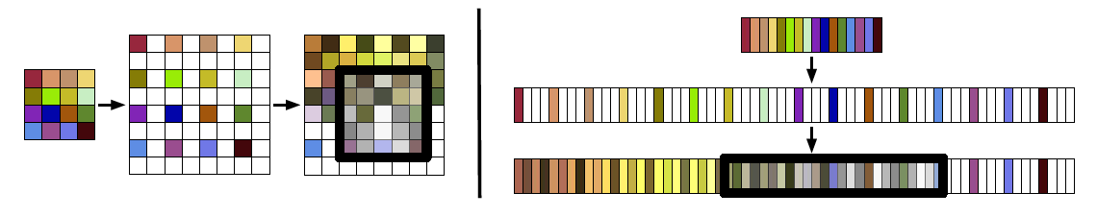
Adversarial Audio Synthesis Donahue et. al, 2018 (ICLR 2019 submission)
Adapt DCGAN architectures to audio
fixed-size images -> fixed-length audio clips
WaveGAN: DCGAN on raw waveforms
5x5 2D convolutions -> 25x1 1D convolutions
Image taken from: https://arxiv.org/pdf/1802.04208.pdf

Slide 3
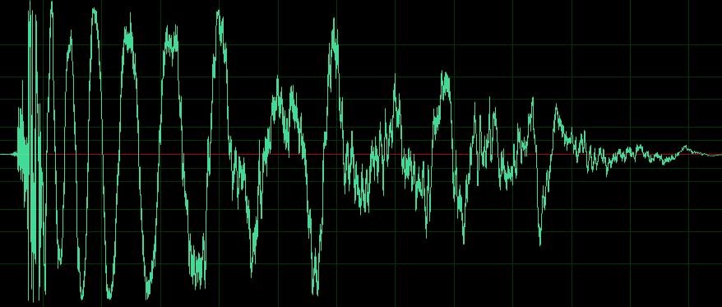
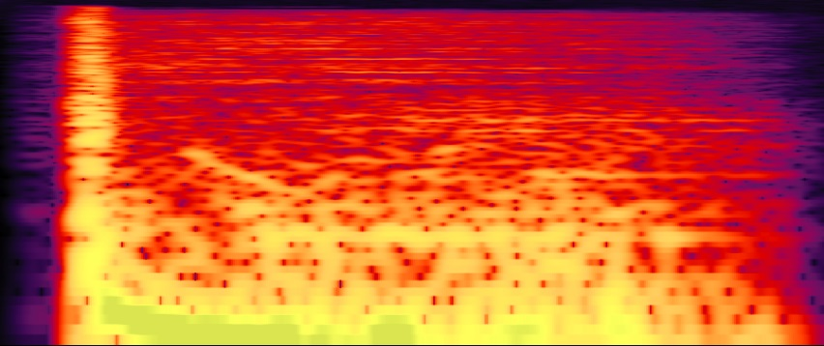
Adversarial Audio Synthesis Donahue et. al, 2018 (ICLR 2019 submission)
Adapt DCGAN architectures to audio
fixed-size images -> fixed-length audio clips
WaveGAN: DCGAN on raw waveforms
SpecGAN: DCGAN on audio spectrograms

Slide 4
Adversarial Audio Synthesis Donahue et. al, 2018 (ICLR 2019 submission)
Adapt DCGAN architectures to audio
fixed-size images -> fixed-length audio clips
WaveGAN: DCGAN on raw waveforms
SpecGAN: DCGAN on audio spectrograms
spectrograms: time-frequency representation
non-invertible (phase info lost)
approximate inverse: Griffin-Lim [1]
degrades audio quality
[1] Griffin & Lim, IEEE Trans. Acoust., Speech, Signal Process. 1984.

Slide 5
Adversarial Audio Synthesis Donahue et. al, 2018 (ICLR 2019 submission)
Adapt DCGAN architectures to audio
fixed-size images -> fixed-length audio clips
WaveGAN: DCGAN on raw waveforms
SpecGAN: DCGAN on audio spectrograms
Findings:
training methods: WGAN-GP loss [4] works best
compared to traditional GAN [1], LSGAN [2], WGAN [3] losses
quantitative results: SpecGAN > WaveGAN
qualitative results: WaveGAN > SpecGAN
[1] Radford et. al, ICLR 2016.
[2] Mao et. al, ICCV 2017.
[3] Arjovsky et. al, ICML 2017.
[4] Gulrajani et. al, NIPS 2017.

